Slide 1
Jean Piaget

Slide 2
How a child thinks.
Sensorimotor stage
Preoperational stage
Formal operations stage
Concrete operations stage

Slide 3

Sensorimotor
First stage
Last from birth to two years
Primary circular reactions (1-4 months)
  Sucking thumb, blowing bubbles
Secondary circular reactions (4-12 months)
  Squeezing rubber duck, making interesting things last
Tertiary circular reaction(12-24 months)
  Hit drum with stick, throwing spoons, dishes, and food

Slide 4
Sensorimotor
Uses senses and motor abilities to understand world
Functions with the present
Has no mental images
Learn through repetitive actions
Accomplish directed behavior

Slide 5

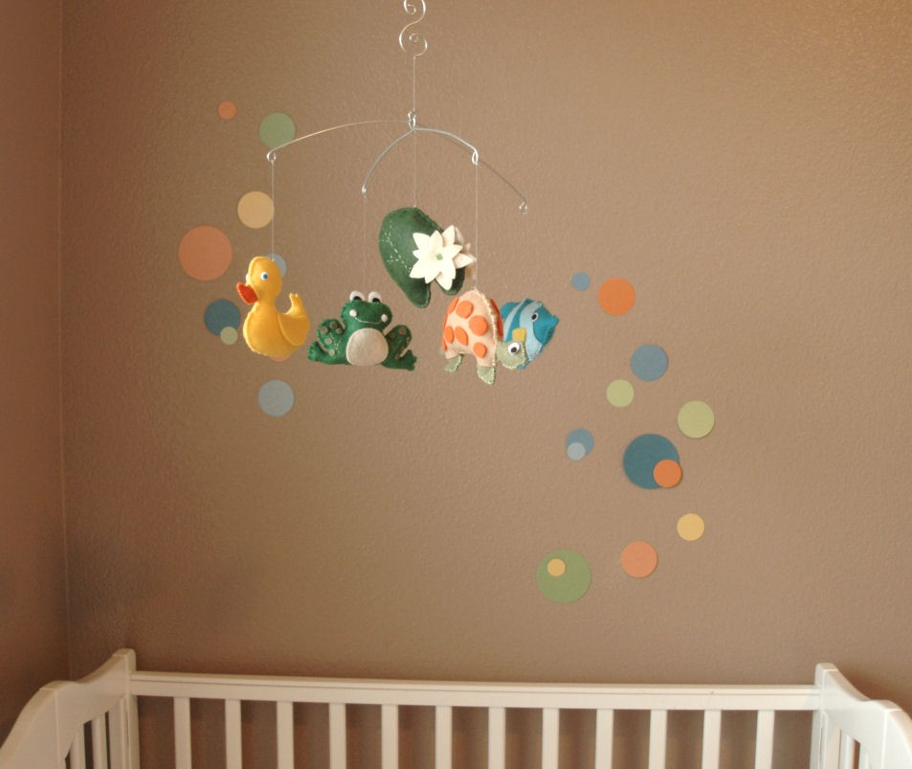
What are the effects?
Positive:
Ex. If a baby kicks a crib and the mobil overhead moves, he kicks again and it moves again.
Learn by doing and procedures
http://www.dreamstime.com/royalty-free-stock-image-ethnic-baby-boy-with-toy-lying-under-blanket-image5322806
Negative:
Ex. Hide a baby’s toy under a blanket and the children will look for it momentarily. Two months later he will look for the toy more determined
After the first time, child will make a habit of looking in the same spot

Slide 6
Preoperational
Second Stage
Two to seven years old
Mental representations and symbols
  Drawing or written word, understand what it’s representing
Clear understanding of past and future
  Know if their mom is coming home, tend to stop crying
Child sees things from their point of view
  Hold up a picture that only they can see, expecting you to see it

Slide 7

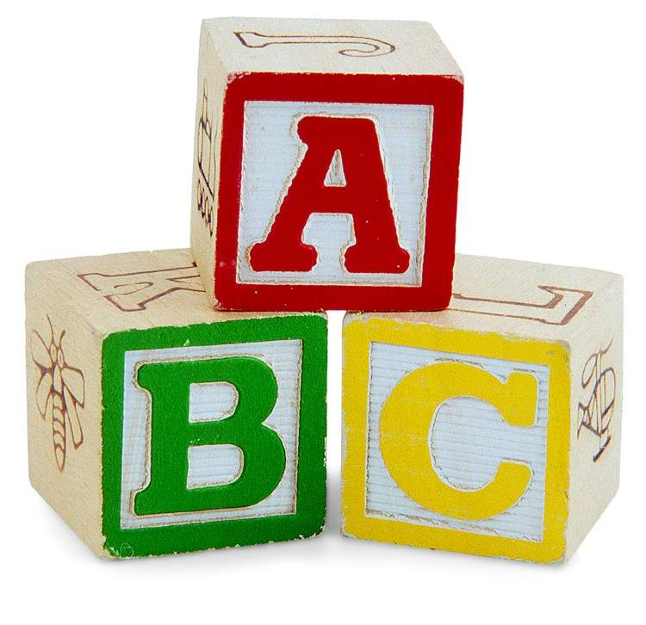
The Effects
Positive
  older people set good examples for children and teach them good examples
  Language development!
Negative:
  Children at this age cannot reason with their parents feelings and only reasoned from what they knew.

Slide 8
concrete
Lasts from about age seven to eleven
Logic Operations / principals
  Solving problems, manipulating symbols
Progressive decentering
  Develop the ability to conserve a number, length
Hard time applying new-found logic abilities
  Simple lesson about judging is too abstract and hypothetical

Slide 9
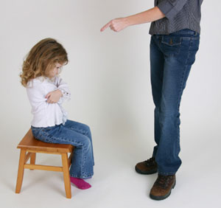
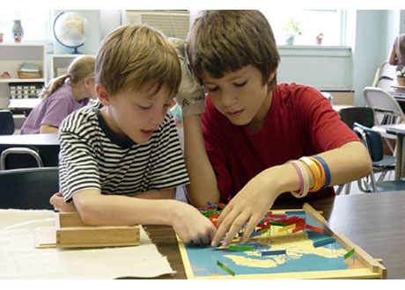
The Effects
Positive
Logical thinking developed about objects and events
Children aren’t as self centered
Aware of rules
http://www.psychologytoday.com/blog/dont-delay/200903/parenting-style-and-procrastination
Negative
Children can become too independent and defy their adult authority

Slide 10
formal
From 12 on
Increasingly competent about adult-style thinking
  Using logical operations, abstract rather than concrete
  Hypothetical thinking
Investigate problem carefully and systematically
Not everyone gets to it
Don’t operate it at all times

Slide 11


The Effects
Negative
Children begin to face the problems that teenagers experience
http://www.australispavestone.com.au/documents/why_australis.html
Positive
Most progress in development occurs (big change)
Reading/new ideas to enhance creativity
http://www.lifework.co.nz/mothers-raising-boys

Slide 12
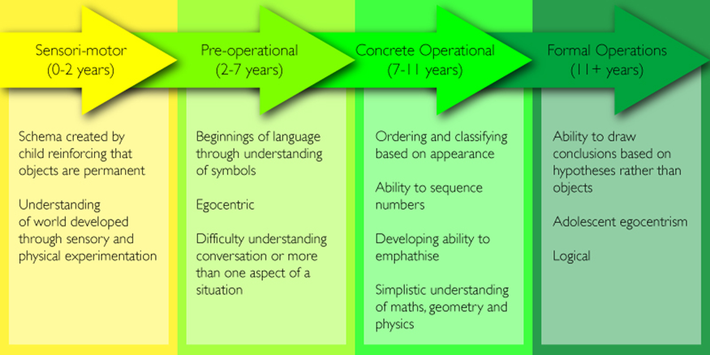
Cognitive development theory
http://learnboutlearning.blogspot.com/

Slide 13
observations
Children don’t think like grown-ups
Children are constantly creating and testing their own theories
  Moon and sun follow you around, big things float and small things sink
All children make similar errors
Don’t know enough to get the same
explanation that adults prefer

Slide 14
conclusion
“Of how much happened in children’s lives before they even started to talk and one of the main themes in all his work since then has been that intelligence can only grow through actual physical as well as mental engagement with the environment”
            ~ about Jean Piaget

